Slide 1



SRM INSTITUTE OF SCIENCE AND TECHNOLOGY
SCHOOL OF COMPUTING
DEPARTMENT OF COMPUTING TECHNOLOGIES
21CSP302L - MINOR PROJECT
Deep-Sea Rescue Support: Human & Object Detection Using Sonar and AI Techniques
Guide name: Dr. Suganiya M
Designation: Assistant Professor
Department: Computing Technologies, School of Computing, SRM Institute of Science and Technology, Kattankulathur Campus, Chennai
Batch ID: B36
Student 1 - Reg. No: RA2311003010826
Student 1 - Name: Akshat Danve
Student 2 - Reg. No: RA2311003010828
Student 2 - Name: Akshat Awasthi

Slide 2
Abstract
Underwater rescue missions require fast, accurate detection and localization of targets in challenging visual environments. Leveraging multibeam sonar data, this work integrates advanced AI techniques with geometric methods to transform raw acoustic images into actionable intelligence. A lightweight YOLO-based model detects small, low-contrast objects in real time, while geometric localization converts image coordinates to precise spatial information. Target prioritization evaluates detection confidence and distance to highlight mission-critical objects. An intuitive interface presents these insights to operators, enhancing decision-making speed and effectiveness in deep-sea rescue scenarios. Unlike existing approaches, this system integrates detection, localization, and prioritization into a unified pipeline.
28/03/2026

Slide 3
Problem Statement
Deep-sea rescue operations depend on multibeam sonar due to poor underwater visibility. However, sonar images are noisy, low-contrast, and difficult to interpret. Operators must manually detect targets, estimate their location, and prioritize actions under severe time pressure. Existing systems lack integrated decision-support combining detection, localization, and prioritization.
Background
  Optical sensing fails at depth; MFLS is the primary modality.
  Sonar imagery contains speckle noise and acoustic artifacts.
  Current systems provide raw data without intelligent decision support.
  Existing research focuses mainly on detection accuracy, not rescue integration.
Need for the Study
  Reduce operator cognitive load
  Enable automatic detection of human & critical targets
  Provide range and bearing estimation
  Prioritize targets based on urgency
  Transform raw sonar data into actionable rescue intelligence
28/03/2026

Slide 4
Objectives
1
Develop a lightweight AI-based framework to accurately detect human and object targets in multibeam sonar imagery.
2
Implement geometry-aware range and bearing estimation to localize detected targets relative to the sonar platform.
3
Design a confidence–proximity prioritization mechanism to rank targets and support rapid rescue decision-making.
28/03/2026

Slide 5
Literature Survey
S. No. | Objective | Dataset Used | Algorithm Used | Research Gaps | Key Inference & Results
1 | Propose first public MFLS sonar dataset for underwater object detection | UATD MFLS sonar dataset | YOLOv5 (baseline) | Limited robustness testing in extreme noise and real-time deployment; small-object density not deeply analyzed | Established benchmark metrics (mAP, precision) and created standard dataset foundation for sonar-based deep learning
2 | Improve deep learning detection for sonar via attention and preprocessing | MFLS sonar images | Enhanced YOLO model | Limited cross-dataset validation; performance under dynamic underwater conditions not fully evaluated | Higher mAP and improved robustness to low contrast & small objects; preprocessing boosts detection performance
3 | Robust small-object detection in underwater images using YOLOv8 | Custom underwater images | AquaYOLO (YOLOv8 enhanced) | Large-scale validation missing; computational cost for embedded/real-time systems not addressed | Accurate detection of small and low-contrast targets; validates YOLOv8 enhancements for UOD
[1] Xie, J., et al. "A Dataset with Multibeam Forward-Looking Sonar for Underwater Object Detection." Nature Scientific Data, 2022.
[2] Ge, M., et al. "Advanced Deep Learning Framework for Underwater Object Detection with MFLS." Remote Sensing, 2024.
[3] Zhang, Y., et al. "AquaYOLO: Enhancing YOLOv8 for Accurate Underwater Object Detection." Sensors, 2025.
28/03/2026

Slide 6
Literature Survey
S. No. | Objective | Dataset Used | Algorithm Used | Research Gaps | Key Inference & Results
4 | Review architectures for underwater object detection and robustness | Various underwater datasets | Survey: YOLO, Faster-RCNN, SOTA | No unified benchmark; limited discussion on deployment challenges | Provides comparative analysis of architectures and highlights robustness challenges
5 | Prioritization and range estimation in SAR (rescue) scenarios | Acoustic images for rescue simulations | Deep CNN + geometry/ranking | Focused mainly on rescue use-case; lacks general underwater object detection benchmarking | Provides actionable cues for rescue operations and improves operator prioritization
6 | Challenge review: datasets and advances in deep learning UOD | Public and custom datasets | Deep CNN approaches, evaluation methods | Dataset imbalance, small-object scarcity, and environmental noise remain unresolved | Summarizes high-accuracy models, research gaps, benchmarking issues, and future directions
[4] Fayaz, R., et al. "Underwater Object Detection Architectures and Algorithms Review." IEEE Access, 2022.
[5] Liu, H., et al. "Underwater Rescue Target Detection Based on Acoustic Images." IEEE Transactions on Image Processing, 2024.
[6] Sui, Y., et al. "Research Challenges, Recent Advances, and Popular Datasets in Deep Learning-Based Underwater Marine Object Detection: A Review." Frontiers in Marine Science, 2023.
28/03/2026

Slide 7
Proposed Methodology
Architecture/Framework
Five-Stage AI-Assisted Pipeline
1. Sonar Data Acquisition (UATD Dataset)
2. Image Preprocessing & Augmentation
3. YOLOv8-Based Target Detection
4. Geometry-Based Localization
5. Confidence-Distance Target Prioritization
Tools & Technologies
Programming Environment: Python 3.x, PyTorch (Deep Learning Framework), Ultralytics YOLOv8
Model & Dataset: YOLOv8-Nano (Pretrained on COCO, fine-tuned on UATD), UATD (Multibeam Forward-Looking Sonar Dataset)
Image Processing: OpenCV
Hardware & Acceleration: NVIDIA GTX 1650 GPU (4GB VRAM), CUDA-enabled training, Automatic Mixed Precision (AMP)
Hybrid AI + Physics-based decision-support framework
28/03/2026

Slide 8
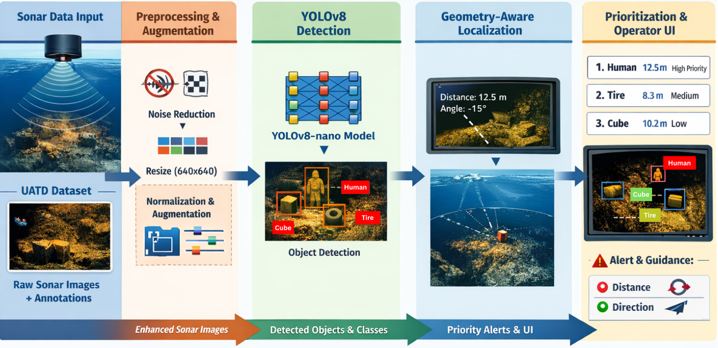
Architecture Diagram
28/03/2026

Slide 9
Dataset & Preprocessing
Dataset
UATD sonar dataset (9000+ images, 10 classes)
Includes human, ROV, and underwater objects
Annotations: Pascal VOC → converted to YOLO format
Preprocessing
Resize to 640 × 640
Intensity normalization
Noise handling (sonar artifacts)
Format conversion: BMP → JPEG
Data Augmentation
Mosaic augmentation
Horizontal flipping
HSV adjustments
Scaling & translation
Key Insight
Handles low contrast & noise in sonar images
Improves small object detection & generalization
28/03/2026

Slide 10
Yolov8 Object Detection
Model Used
YOLOv8-Nano (YOLOv8n)
Lightweight, real-time object detection model
Pretrained on COCO dataset, fine-tuned on sonar data
Key Features
Efficient multi-scale feature extraction
Improved small object detection
Faster inference with fewer parameters (~3.2M)
Why YOLOv8n?
Suitable for low-resource hardware
Enables near real-time performance
Balanced accuracy vs speed trade-off
Output
Bounding boxes
Class labels
Confidence scores
28/03/2026

Slide 11


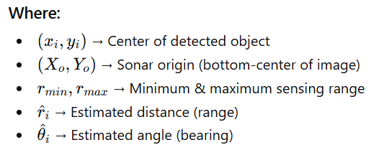
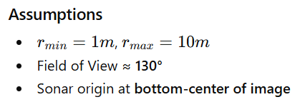
Geometry-Based Localization
Range Estimation
Bearing Estimation
28/03/2026

Slide 12
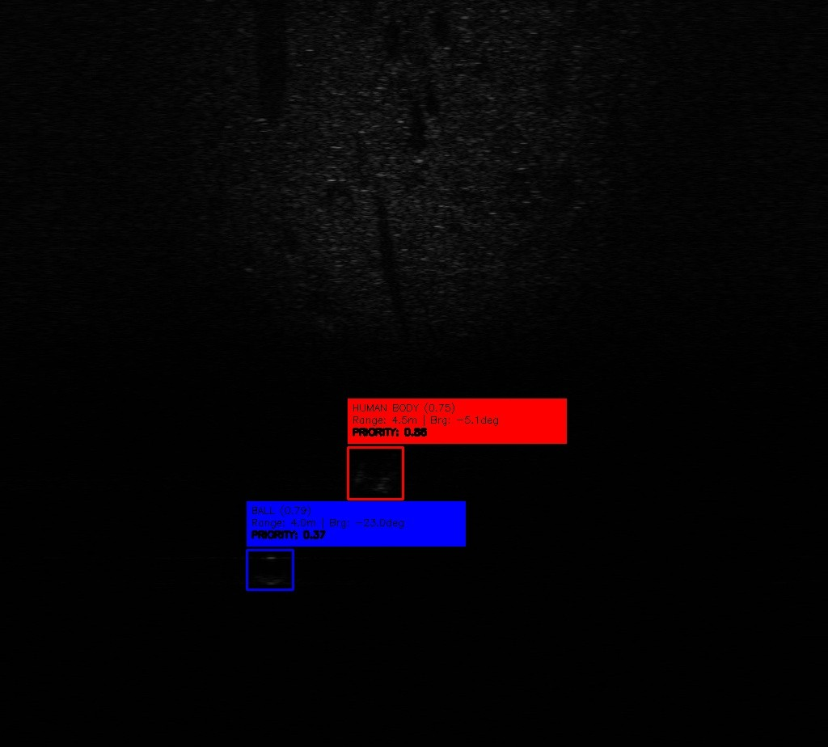

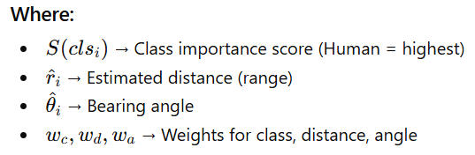
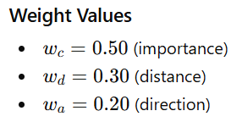
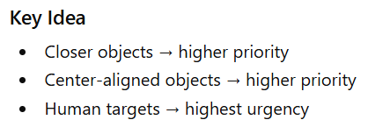
Target Prioritization Model
Priority Score
28/03/2026

Slide 13
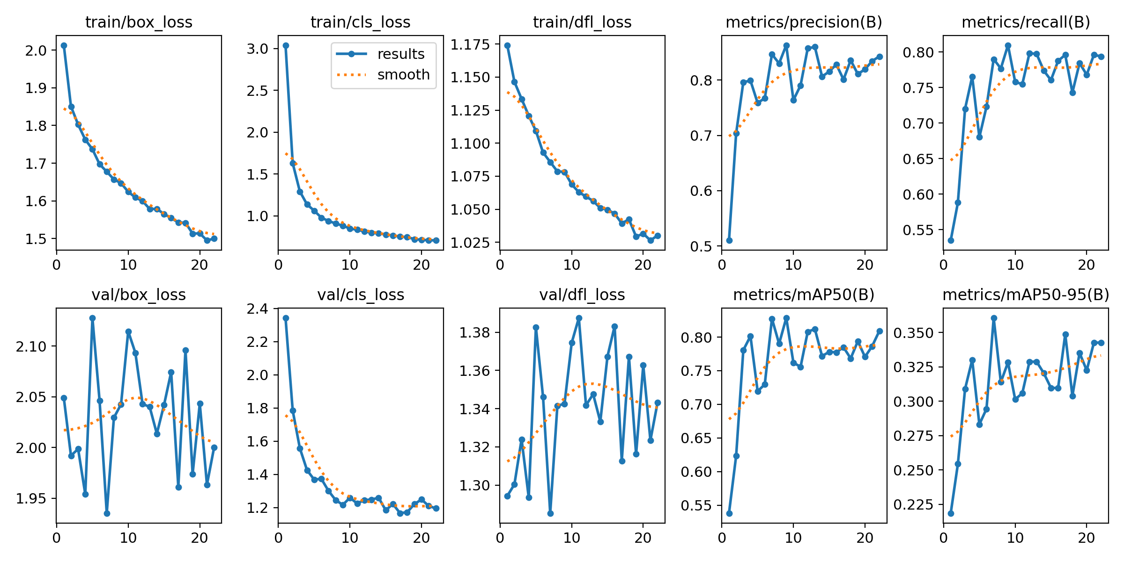
Model Performance
Evaluation Metrics
mAP@0.5: 82.6%
Human Detection mAP: 85.2%
Precision: 73.7%
Recall: 86.8%
Key Observations:
Strong performance on human detection (rescue-critical class)
High recall → low missed detections
Stable performance across test data
Training curve (loss + mAP vs epochs)
28/03/2026

Slide 14
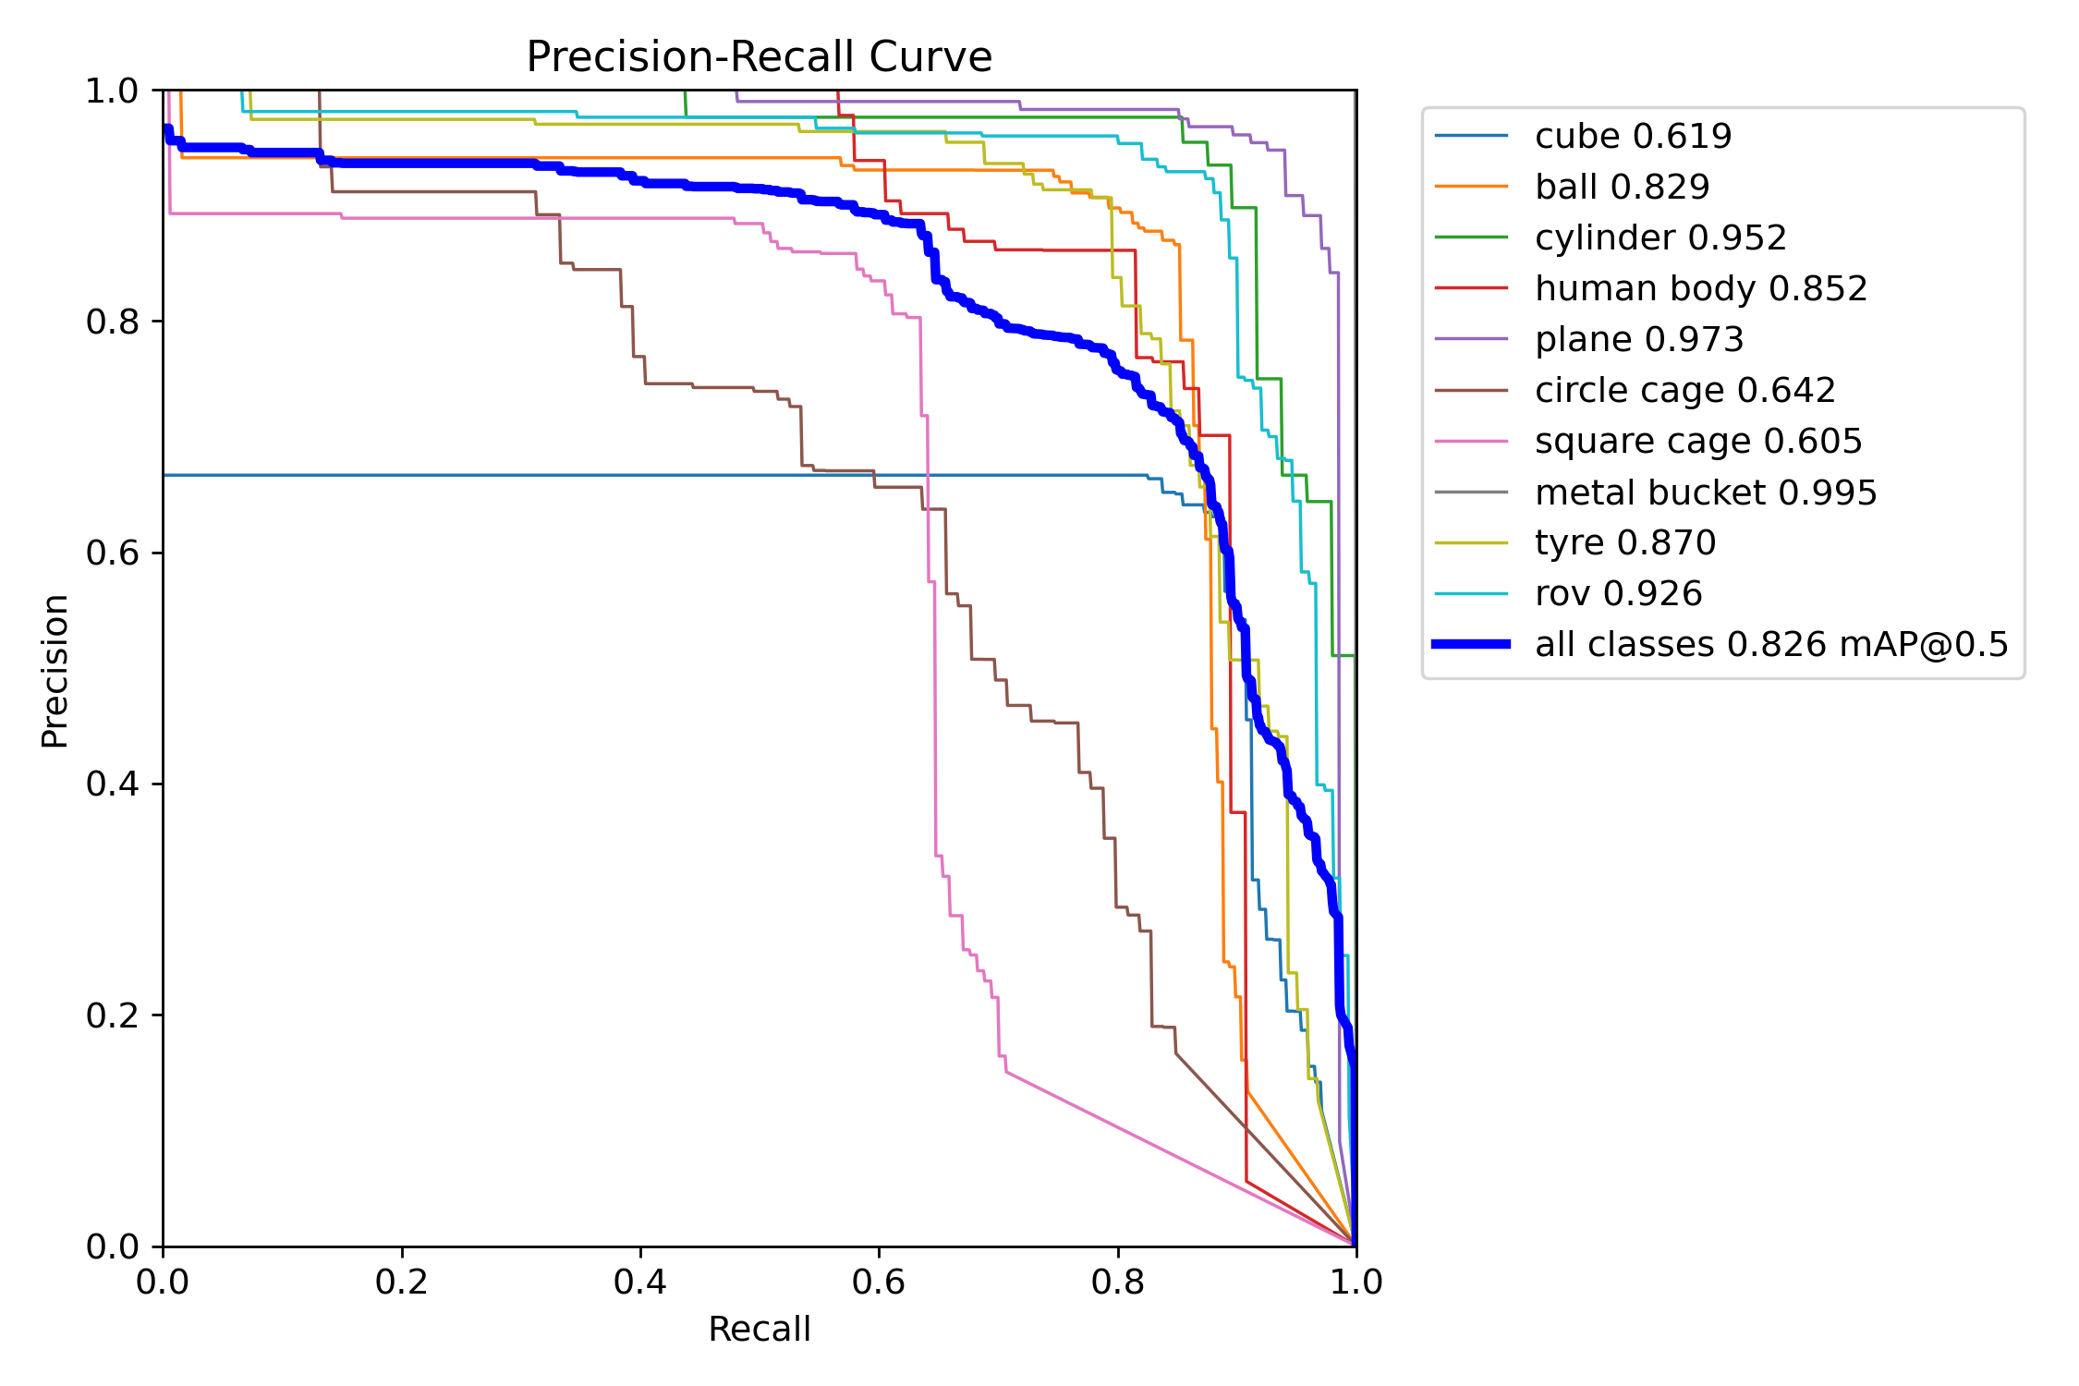
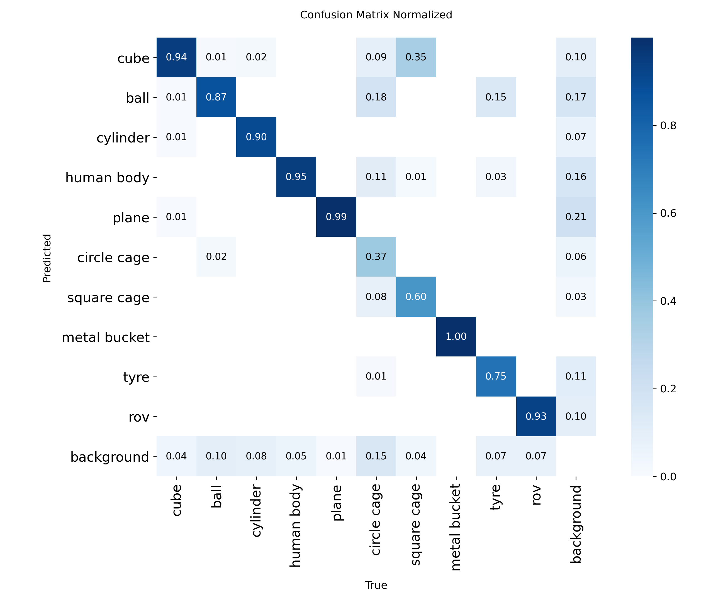
Performance Analysis
Precision–Recall Curve
Shows balance between precision and recall
Indicates consistent detection performance
Confusion Matrix
High true positives for human class
Minimal confusion between major classes
28/03/2026

Slide 15
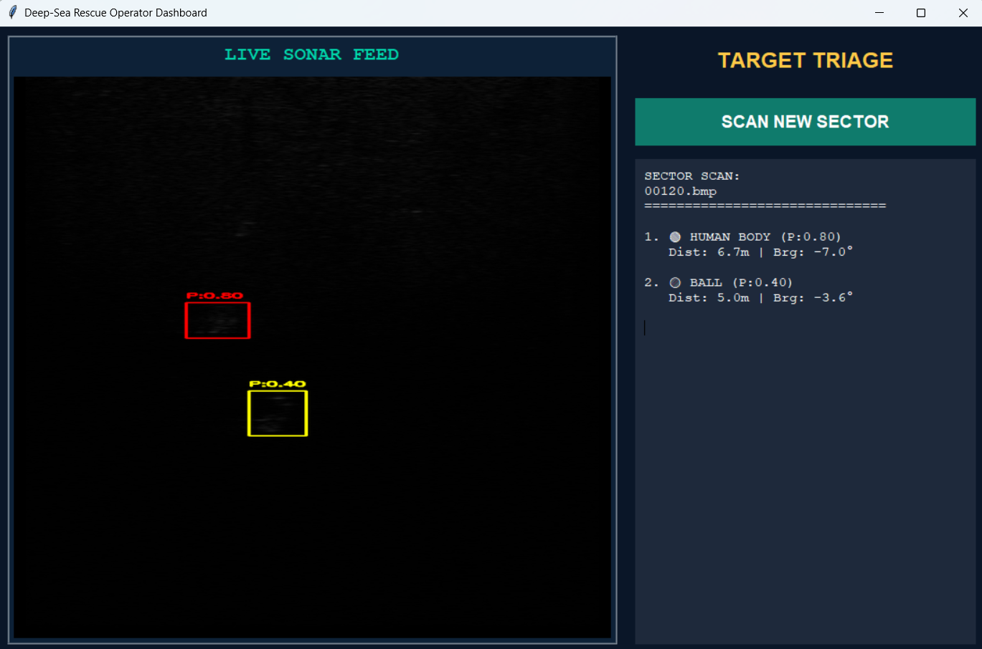
Operator Dashboard & System Output
Output Information
Detected objects with bounding boxes & labels
Confidence scores for each detection
Confidence scores for each detection
Priority ranking of targets
Key Features
Combines detection + localization + prioritization
Provides real-time situational awareness
Enables fast and informed decision-making
28/03/2026

Slide 16
Comparison with Existing Methods
Study | Model | mAP@0.5 | Key Limitation
Wang et al. (2022) | PP-YOLOv2 | ~0.82 | Detection only
Li et al. (2024) | CCW-YOLOv5 | ~0.85 | No prioritization
Fan et al. (2022) | STAFNet | ~0.88 | High computation
Zhang et al. (2024) | DSML-YOLO | ~0.84 | No localization
Proposed Work | YOLOv8n | 82.6% | Detection + Localization + Prioritization
Unlike existing methods, our system provides end-to-end decision support, not just object detection.
28/03/2026

Slide 17
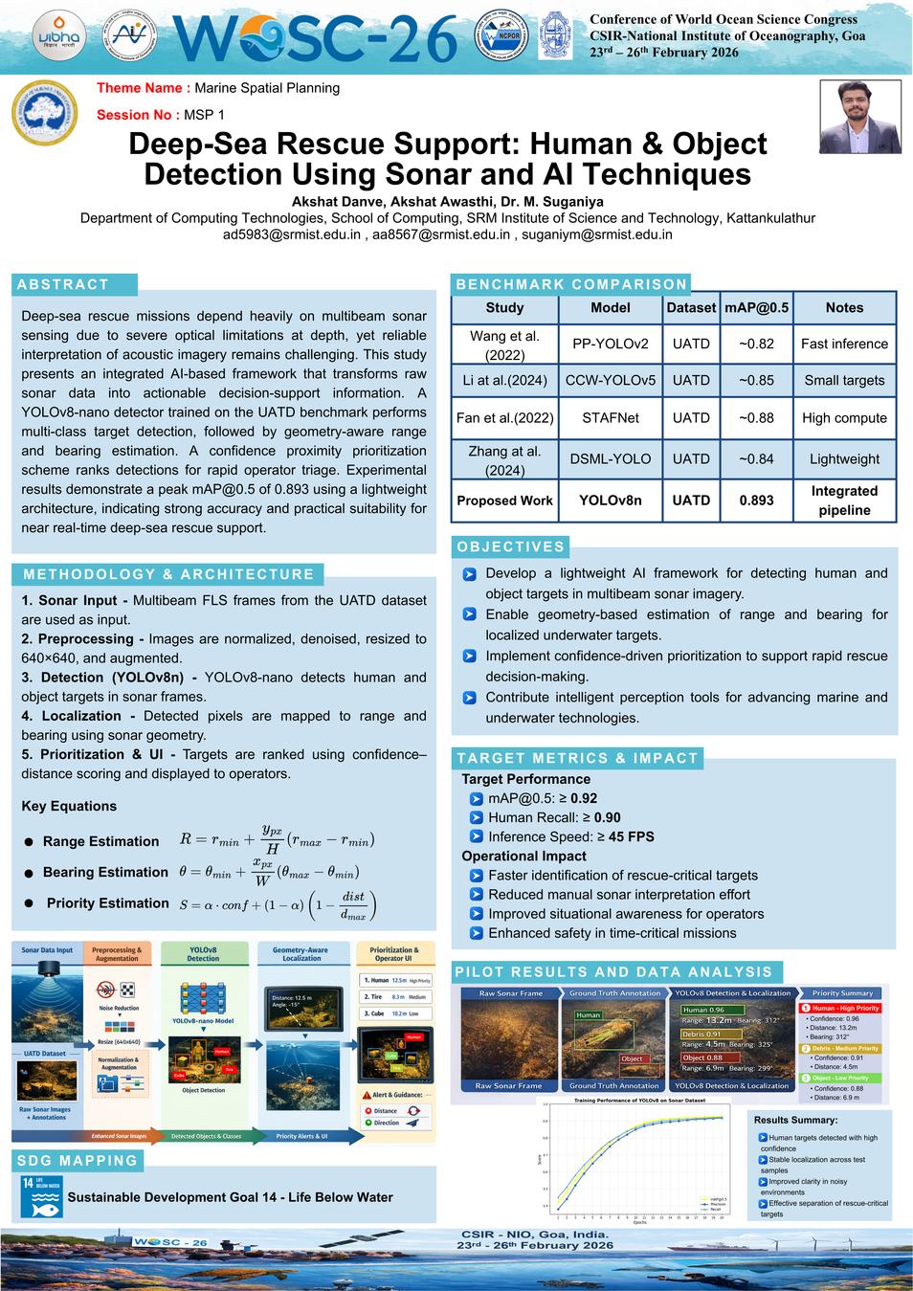
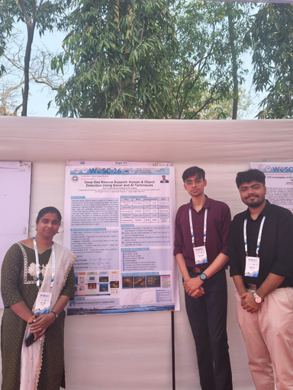
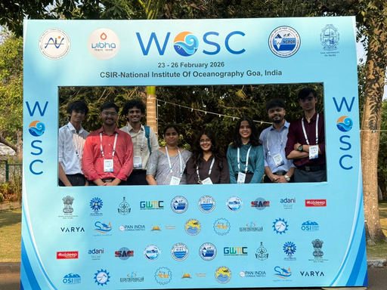
Publication
Published in the conference proceedings at the World Ocean Sciences Congress (WOSC 2026), CSIR-NIO, Goa – 23rd to 26th February
28/03/2026

Slide 18
Work Plan / Timeline
Phase | Nov | Dec | Jan | Feb | Mar | Apr
Project Planning & Research Preparation
Initial Model Development & Experiment Setup
Data Processing & Augmentation
Model Training
System Integration & Interface Development
Evaluation & Documentation
Final Submission
Conference and Publications
28/03/2026

Slide 19

SDG Mapping
Aligned with: United Nations Sustainable Development Goal 14 – Life Below Water
  Enhances marine safety operations
  Supports underwater rescue and disaster response
  Improves situational awareness in ocean environments
  Contributes to intelligent marine spatial technologies
28/03/2026

Slide 20
Conclusion
Summary of Proposed Work
  Developed an integrated AI-based framework for deep-sea rescue support.
  Implemented YOLOv8-nano for accurate detection of human and underwater objects in multibeam sonar imagery.
  Introduced geometry-aware range and bearing estimation for spatial localization.
  Designed a confidence–proximity prioritization mechanism to rank rescue-critical targets.
  Achieved strong detection performance (mAP@0.5 ≈ 82.6%) using a lightweight architecture suitable for near real-time applications.
Future Scope
  Improve detection performance with extended training and model tuning.
  Integrate multi-frame object tracking for dynamic rescue scenarios.
  Deploy on embedded GPU platforms (Jetson / onboard ROV systems).
  Combine with SLAM for real-time underwater mapping.
  Expand toward full-scale intelligent rescue decision-support systems.
28/03/2026

Slide 21
References
[1] R. Girshick, "Fast R-CNN," in IEEE International Conference on Computer Vision (ICCV), 2015, pp. 1440-1448.image.jpg​
[2] J. Redmon, S. Divvala, R. Girshick, and A. Farhadi, "You Only Look Once: Unified, Real- Time Object Detection," in CVPR, 2016.
[3] A. Bochkovskiy, C.-Y. Wang, and H.-Y.M. Liao, "YOLOv4: Optimal Speed and Accuracy of Object Detection," arXiv preprint arXiv:2004.10934, 2020.
[4] Z. Wang, M. Li, J. Zeng, and X. Li, "MAL-YOLO: A Lightweight Algorithm for Target Detection in Side-Scan Sonar Images," IEEE Access, vol. 8, pp. 156123-156134, 2024.
[5] United Nations, "Transforming our world: The 2030 agenda for sustainable development," 2015.
[6] S. Xu et al., "Green Ecosystem Monitoring: Using AI for Marine Conservation," Environmental Science & Technology, vol. 54, no. 7, pp. 4200–4210, 2020.
[7] K. Lee et al., "Deep Learning Approaches for Underwater Image Analysis," IEEE Transactions on Geoscience and Remote Sensing, vol. 59, no. 4, pp. 3060–3074, April 2021.
[8] G. Brown, S. Patel, and K. Rao, "Sonar Image Object Detection Using Deep Neural Networks," Journal of Marine Technology, vol. 88, no. 2, pp. 123-135, 2022.
28/03/2026

